Slide 1
Designing Experiences, Engineering Outcomes
MARCH 2020

Slide 2
HELLO

Slide 3
CONTENTS
01 Setting the scene
02 Our vision
03 Our approach
04 How we’ll deliver
05 A bit more about us

Slide 4
Setting the scene

Slide 5
Drive revenue growth by attracting, retaining & delighting customers through a consistent, customizable experience across the CBRE service lifecycle.
CBRE’S BUSINESS GOAL

Slide 6
What we’ve been hearing
OBJECTIVES
ATTRACT AND RETAIN CUSTOMERS
Win business based on ability to deliver as well as sell using personas and outcomes
Truly differentiate technology offering from competitors
Sell more to 3x accounts - it’s easier to add another service when it’s an extension of an existing application
IMPROVE CUSTOMER SATISFACTION
Improved customer satisfaction by providing clients with a coherent user experience throughout the lifecycle
CBRE is eager to find a partner to help evolve myVantage into a full-fledged experience portal.

Slide 7
The scope you’re looking at
MVP
FOUNDATIONAL CAPABILITIES
Vantage analytics embedded in UI
Customizable layouts
Administration interface
Multi-tenancy
SSO-enabled entry points
POST-MVP
ADDITIONAL FEATURES
Document management integration
Account team directory widget
Chatbot Integration for FAQ
Consolidated search Capabilities
Social media integration
Collaboration tools
Internationalization
Live agent chat Integration
BUILT ON
PHASE 1 MYVANTAGE – SALES DEMO APP
Responsive web application
Technology stack – Azure ADB2C, Angular, .NET Core, PostgreSQL
Global focus – Azure regions, data residency, compliance and resiliency requirements
Notes:
Prioritize backlog – regardless of MVP-POST-MVP framework
DevOps
CICD – automated testing
Building CICD pipeline part of plan

Slide 8
Our vision

Slide 9
OUR VISION
Collaboratively define and bring to life meaningful experiences for customers and account teams by continuing our partnership with CBRE in taking myVantage into its next phase.

Slide 10
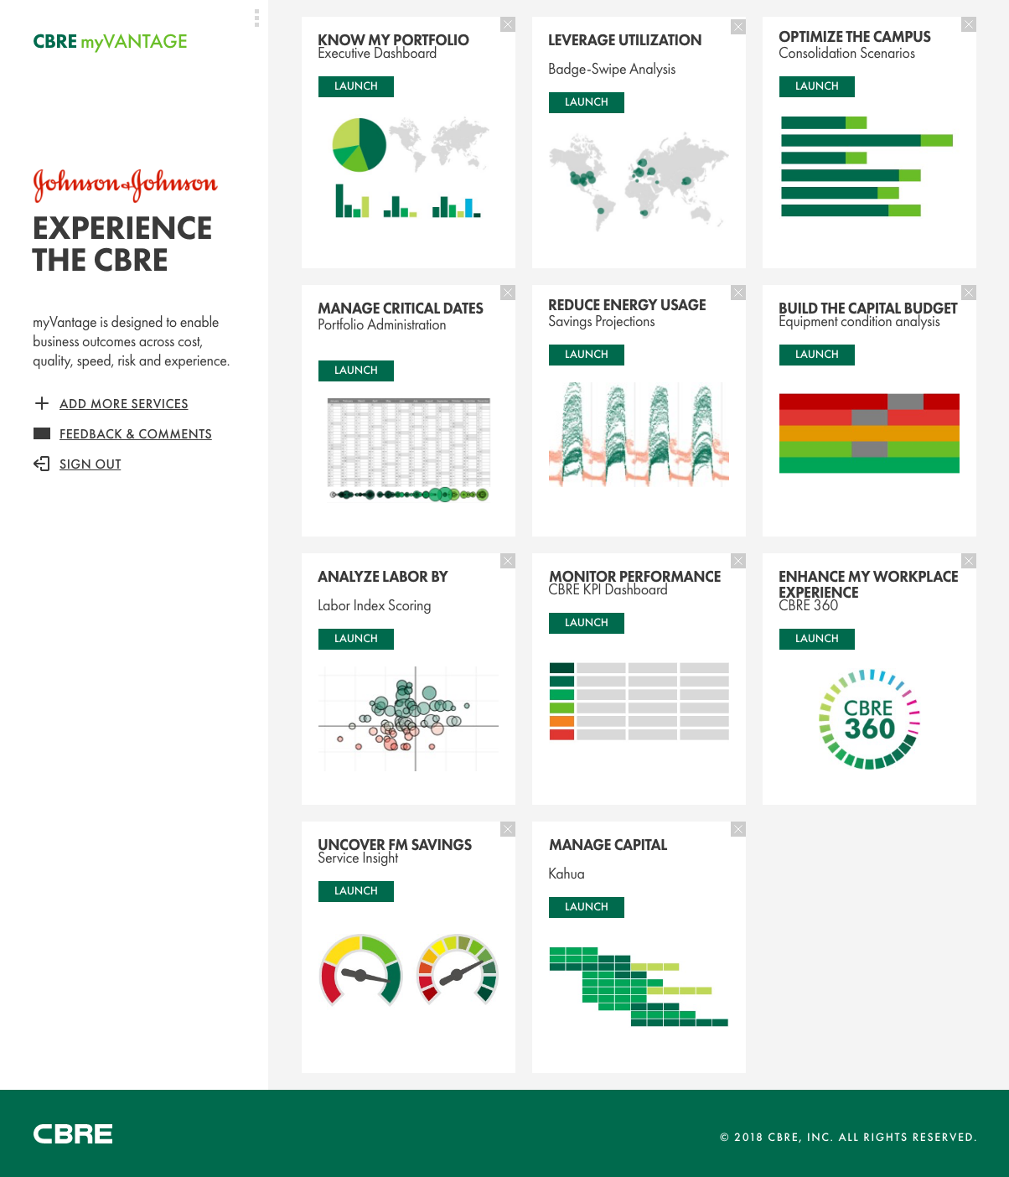
Together, we’ll build off of what we started…

Slide 11
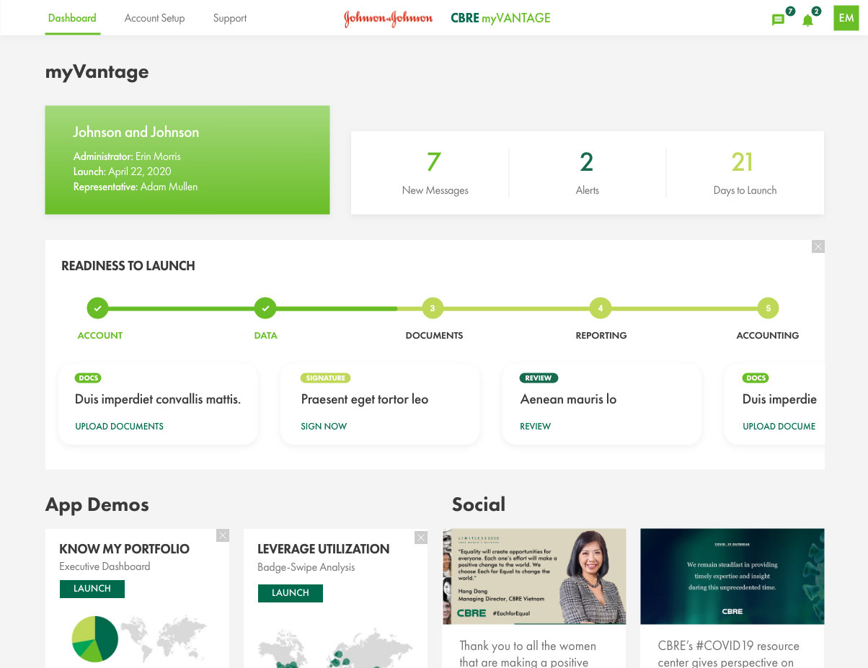
…and transform how CBRE customers transition…
*Concept design is illustrative. All concepts and features are not representative of MVP scope

Slide 12
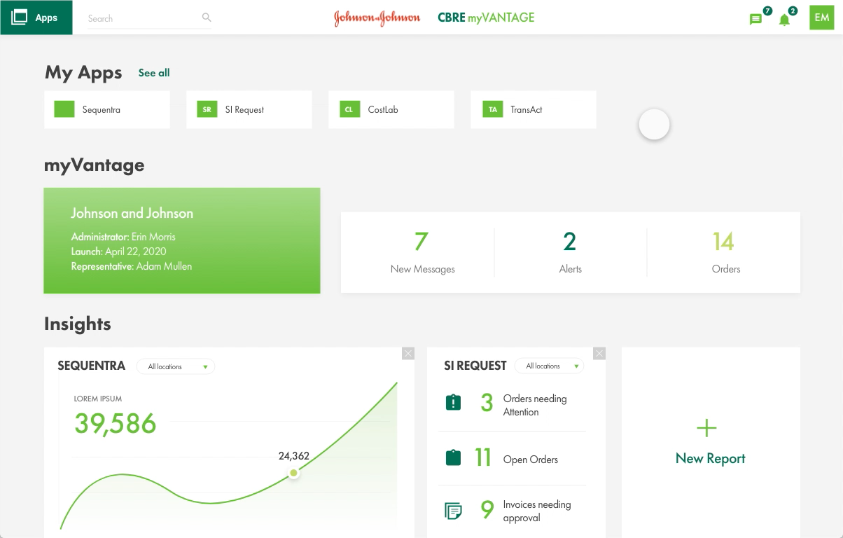
…and transform their business
*Concept design is illustrative. All concepts and features are not representative of MVP scope

Slide 13

HOW TO DO IT (OUR INITIAL POV)
Establish a solution that delivers user satisfaction while enabling integration & scalability
Rich UX that aligns to the client’s CBRE lifecycle | API first approach and support for multiple SSO protocols | Scalable, flexible and fault tolerant architecture | Extensible, maintainable and separation of concern
The architecture would leverage extensive research done by our team to identify client lifecycle needs and preferences and build flexible business logic in app to support visualizations | Extensive use of existing application APIs, API gateway and integration points. Build microservices-based capabilities and leverage industry standards for SSO protocol integrations | Build redundancy at each layer, utilize industry standard, cloud native approach for achieving scalability and flexibility | Separation of concern in business services and account services by leveraging/exposing API for both

Slide 14
Set up a strong and scalable technical foundation...
USERS
(Head of Real estate,
Facility Manager, Project Manager)
INTEGRATION LAYER
Desktop /Mobile/Tablets
WEB USER INTERFACE
HTML5, Angular 8.0
myVantage Portal UI
Identify Access, SSO Azure B2C
Azure CDN
API MANAGEMENT /
API GATEWAY
Azure Blob Storage
Protocol / Data Transformation
Security & Authorization
Routing & Load Balancing
Azure API Management
Azure Search
MICRO SERVICES (REST API)
Sequentra , Kahua
SI
CORE SERVICES
ASP.NET Core 3.1 Web API ,C#, Entity
Core
Dashboard
Account
Document
Admin
Tableau
Sales
Transition
Transformation
Go Live Services
Social Integration
Twitter, Instagram
Azure SQL
PostgreSQL SQL
Chat Bot
Azure QNA Maker
CROSS-CUTTING CAPABILITIES
Live Chat Agent
Logging & Exception Handling
DevOps (CI/CD)
Infrastructure Monitoring
High Availability & Scalability
Identity Access Management

Slide 15
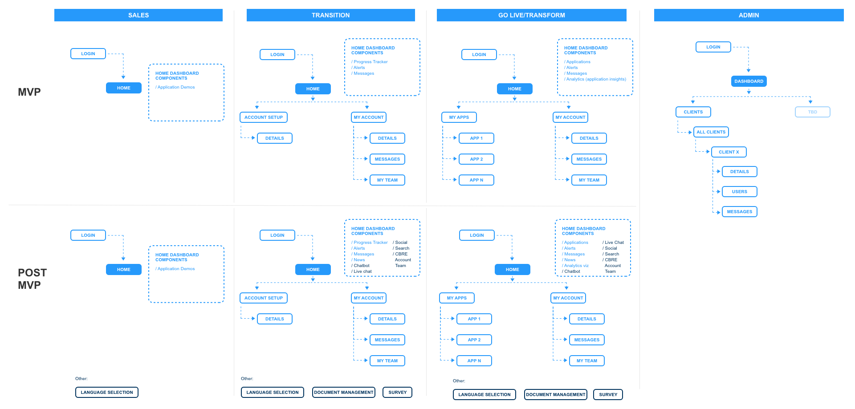
…and partner that with a scalable information architecture
Information Architecture is indicative of future state and will be refined in discovery

Slide 16
We’ve done this before, and we know what typically makes this hard.
WHAT’S HARD
HOW WE ADDRESS IT
Designing customer experiences that drive desired impact
Building with quality & efficiency
Alignment of partners to your business, organization and tech ecosystem
We lead with user-centered research to align design with clear & actionable objectives
We integrate design & engineering using a DevOps approach to enhance speed
We helped create & deliver myVantage and will bring these learnings to the next phase

Slide 17

DRIVING INNOVATION WITH RESEARCH
Millennials are not buying life insurance. Their apathy could doom the industry as a whole. Prudential approached us to help develop new life insurance products that would be more relevant and better suited to the needs of this toughest cohort of buyers.
We created an ‘Investment Thesis’ that demonstrated what the product vision was, the infrastructure required to support it, how to begin realizing the vision based on current affairs and the expected revenues, profitability, and overall impact.
PRODUCTS LAUNCHED | Team members
2 | 15+

Slide 18

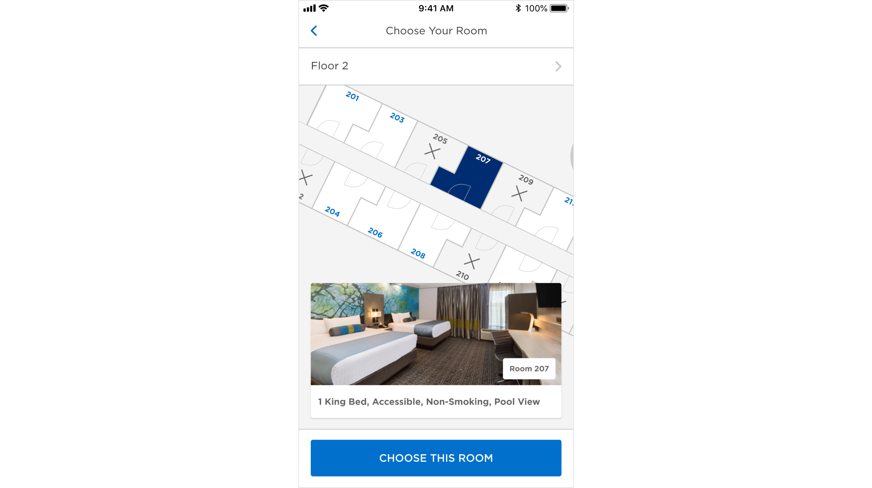
INTEGRATED DESIGN & DEVELOPMENT
Redesign and development of brand’s global mobile application. App features choose your room, booking, loyalty and on-prem functionality, including check-in, digital room key, folio and more.
Delivered using SAFe we will have delivered 2,400 story points across 9 PODs, integrating design, native dev, AEM, services dev, middleware dev, and PMS integration workstreams.
Months to Delivery | Team members
6 | 100+

Slide 19

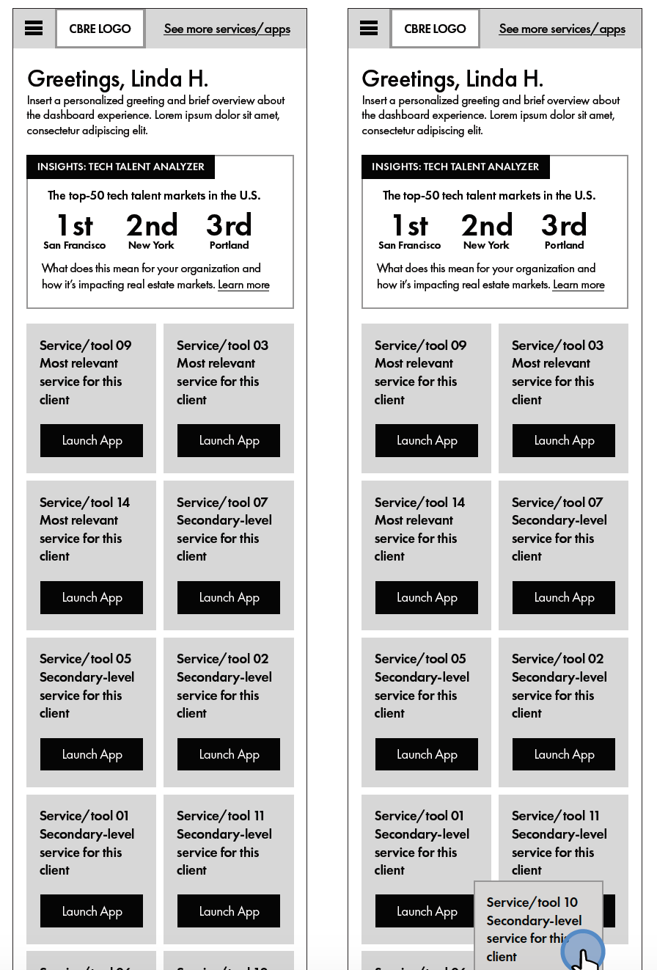
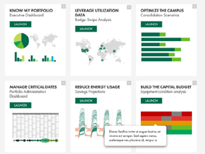
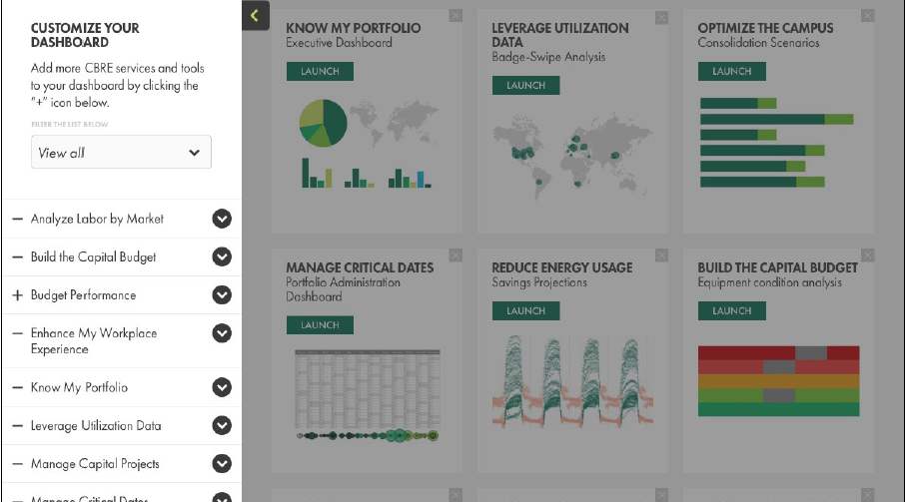
MYVANTAGE PHASE 1
CBRE wanted to develop a demo for sales agents to present their suite of technologies for prospective clients.
We identified, designed, and built a web and mobile-responsive site that is SSO-enabled and allows users to create, customize, save, and share demos with advanced features such as client and feature customization. One single tool to not only make the sales presentation but also to showcase all their technologies in the live environment.
FASTER DEVELOPMENT | SALES USERS SUPPORTED
90% | 200+

Slide 20
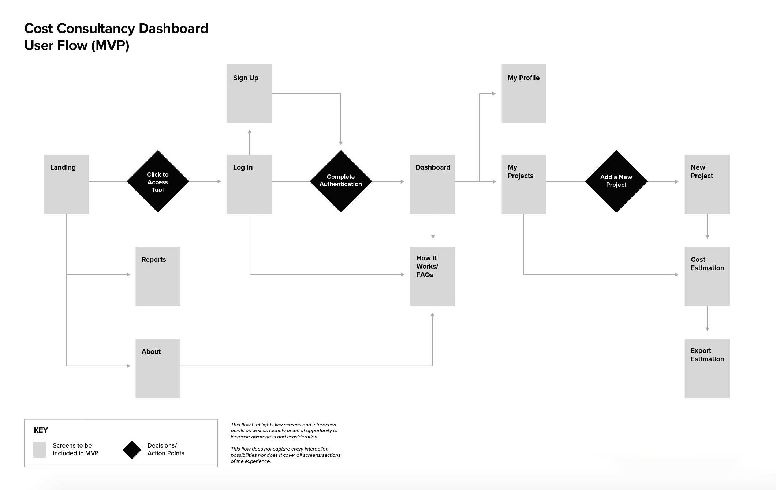
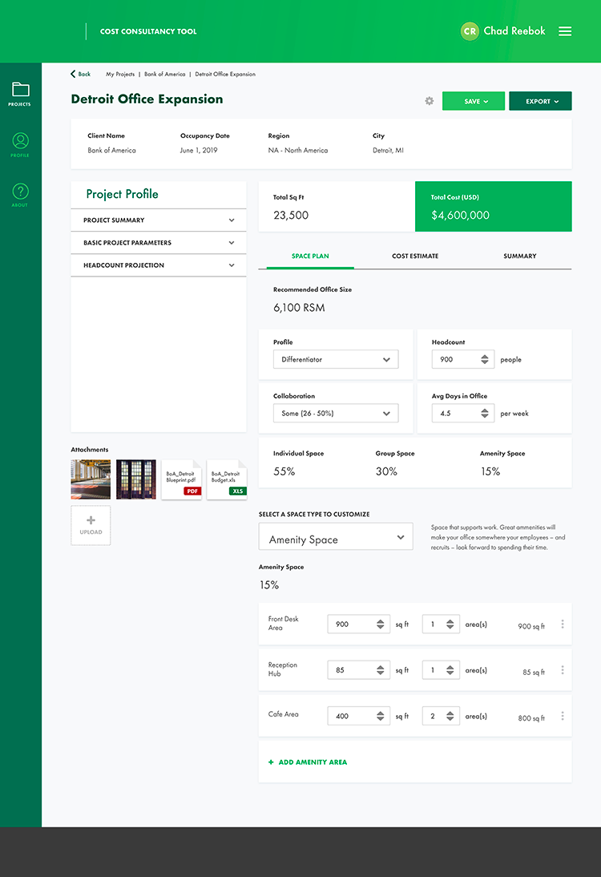
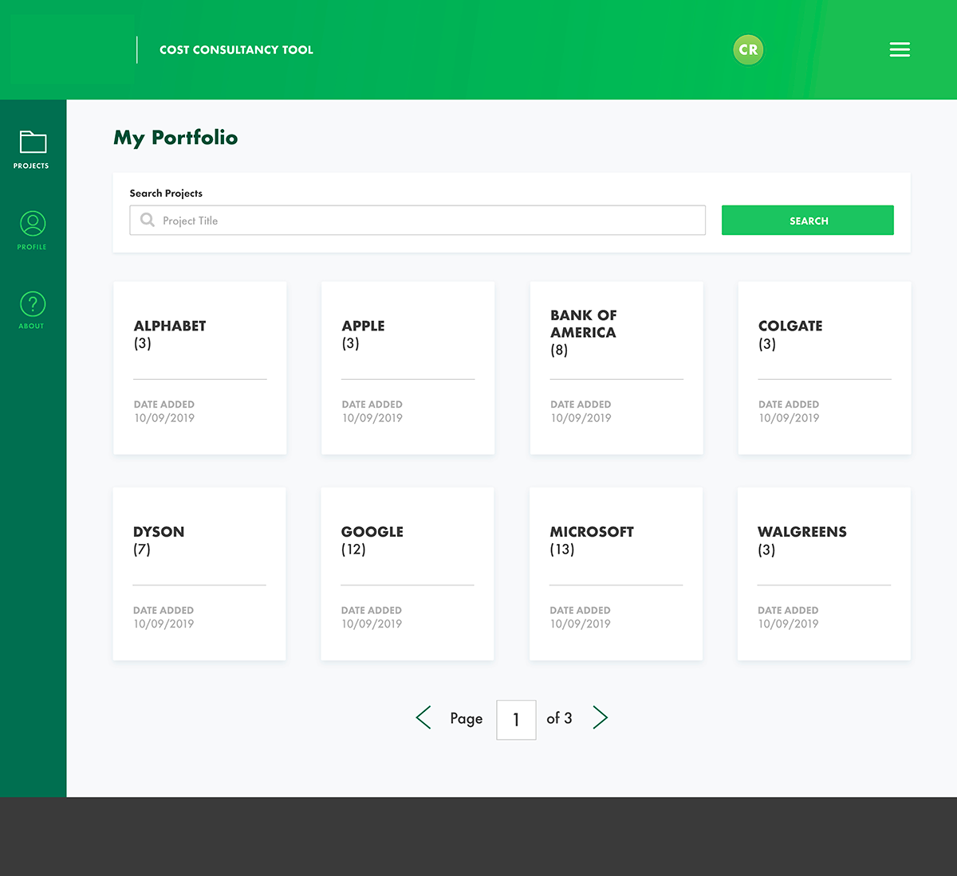
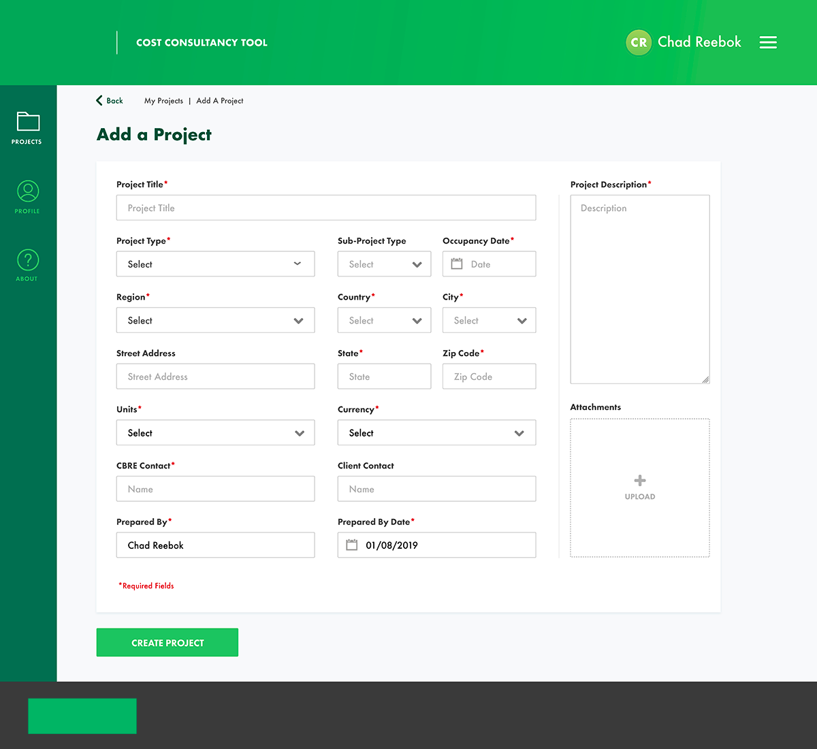
ASSOCIATE EXPERIENCE DESIGN
CBRE was seeking to improve the field agent experience of supporting the customers who are interested in learning about onsite costs of floor plans when redesigning or building a new office space.
We designed and developed a responsive interface that enables not only online, but tablet and mobile views into cost estimated for property management. One interface design that reduces the need to have multiple systems in place to support field associates for their need to give customers a personalized experience.
ROI | USERS SUPPORTED
8:1 | 2000+

Slide 21
Our approach

Slide 22
Cognizant is in a unique position to deliver successfully
The short story: We bring it all together
User Centered Research & Design Methodology | Integrated Product Design and Engineering | Scalable Technology Platform | Cost Effective Partnership
An iterative approach focused on building user love by creating products that excite to drive adoption and retention | Integrating product, design, and development to minimize handoffs, create better collaboration, and get to a better product, faster | Engineering a cloud-first platform using the best of the breed technologies | Seamless transition leveraging organizational and technical learnings from existing myVantage partnership

Slide 23

We’ll bring the next phase of myVantage to life with our end-to-end design & engineering process
We use human insight to take ideas from vision to outcome in an agile model
KICKOFF
APRIL 6
RESEARCH
STRATEGY
MVP LAUNCH
OCT 5
DESIGN
BUILD
LAUNCH
MONITOR & OPTIMIZE
Looking at the problem from all angles – business, people, technology
Sensemaking & co-creating to develop product vision, personas, concepts, content strategy and roadmap
Define technical solution architecture and integration strategy
Identifying requirements, feature lists, user stories, and build plan
Creating a comprehensive agile sprint plan to build the new experience
Designing the new experience with best-in-class creative
Iterative and seamless hand-offs between design and development
Deploying myVantage portal to UAT environment for business validation and feedback
Iteratively improving the product with learnings from UAT
Production cutover and monitor
EVOLVE
INTEGRATION WITH EXPERIENCE STRATEGY, USER RESEARCH & TECHNOLOGY

Slide 24
How we turn ideas into strategy
RESEARCH
STRATEGY
DESIGN
BUILD
LAUNCH
MONITOR & OPTIMIZE
Looking at the problem from all angles – business, people, technology
Sensemaking & co-creating to develop product vision, personas, concepts, content strategy and roadmap
Define technical solution architecture and integration strategy
Identifying requirements, feature lists, user stories, and build plan
Creating a comprehensive agile sprint plan to build the new experience
Designing the new experience with best-in-class creative
Iterative and seamless hand-offs between design and development
Deploying myVantage app to UAT environment for business validation and feedback
Iteratively improving the product with learnings from UAT
Production cutover and monitor
EVOLVE
Integration with Experience Strategy & User Research

Slide 25
Research and strategy: key activities and deliverables
// IMMERSE
// UNDERSTAND
// IDEATE
2 WEEKS
3 WEEKS
2 WEEKS
ORGANIZE, UNDERSTAND & ALIGN MYVANTAGE CONTEXT & NEEDS
DETERMINE A HUMAN-CENTERED MYVANTAGE EXPERIENCE
CO-CREATE THE FUTURE MYVANTAGE EXPERIENCE
Kickoff & alignment Stakeholder interviews Document, business, and platform immersion Research planning Target architecture draft and review | User research Insight synthesis Persona development Content audit CBRE tools and technology inventory / Target architecture finalization | Story mapping workshop Concept co-creation Backlog development Information architecture design Technical stories creation and mapping
Project charter Research plan Meeting / workshop schedule | User personas Topline insights Functional architecture Technical architecture | Story map Backlog Draft sitemap Content blueprint
ACTIVITIES
DELIVERABLES

Slide 26
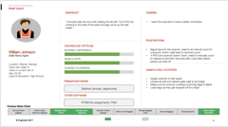
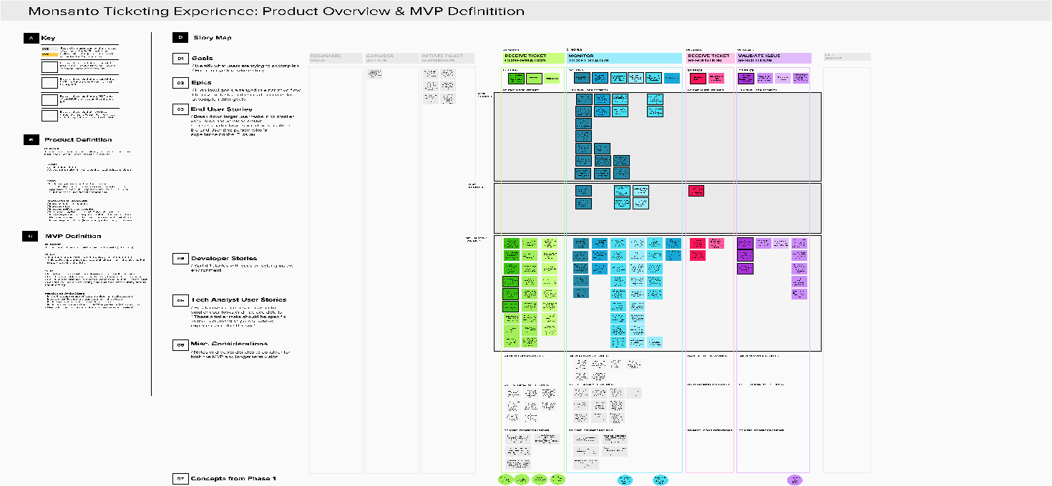
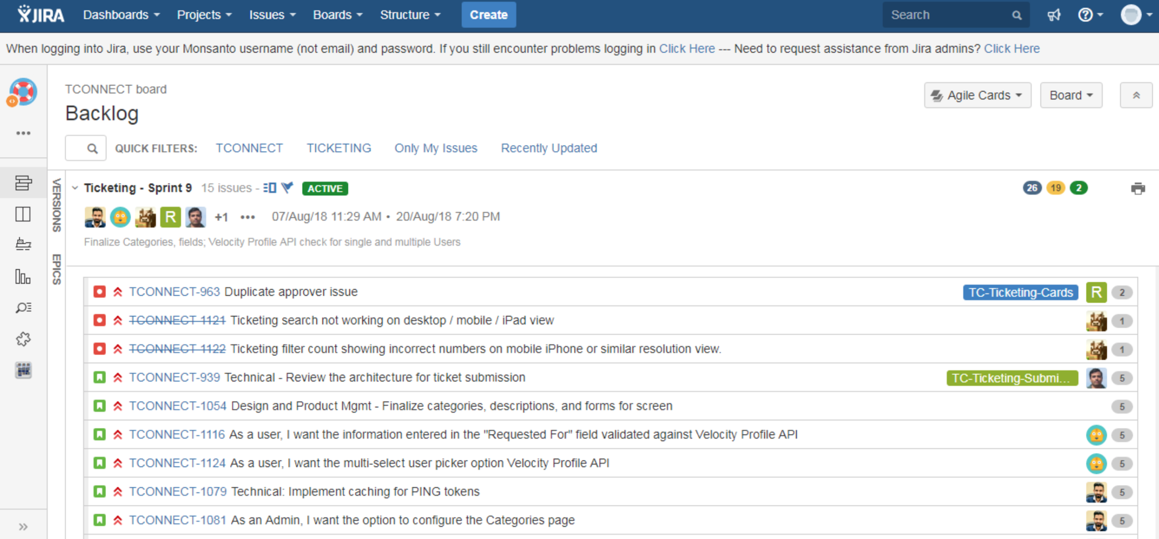
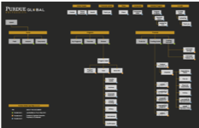
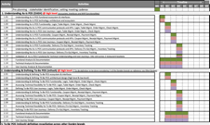
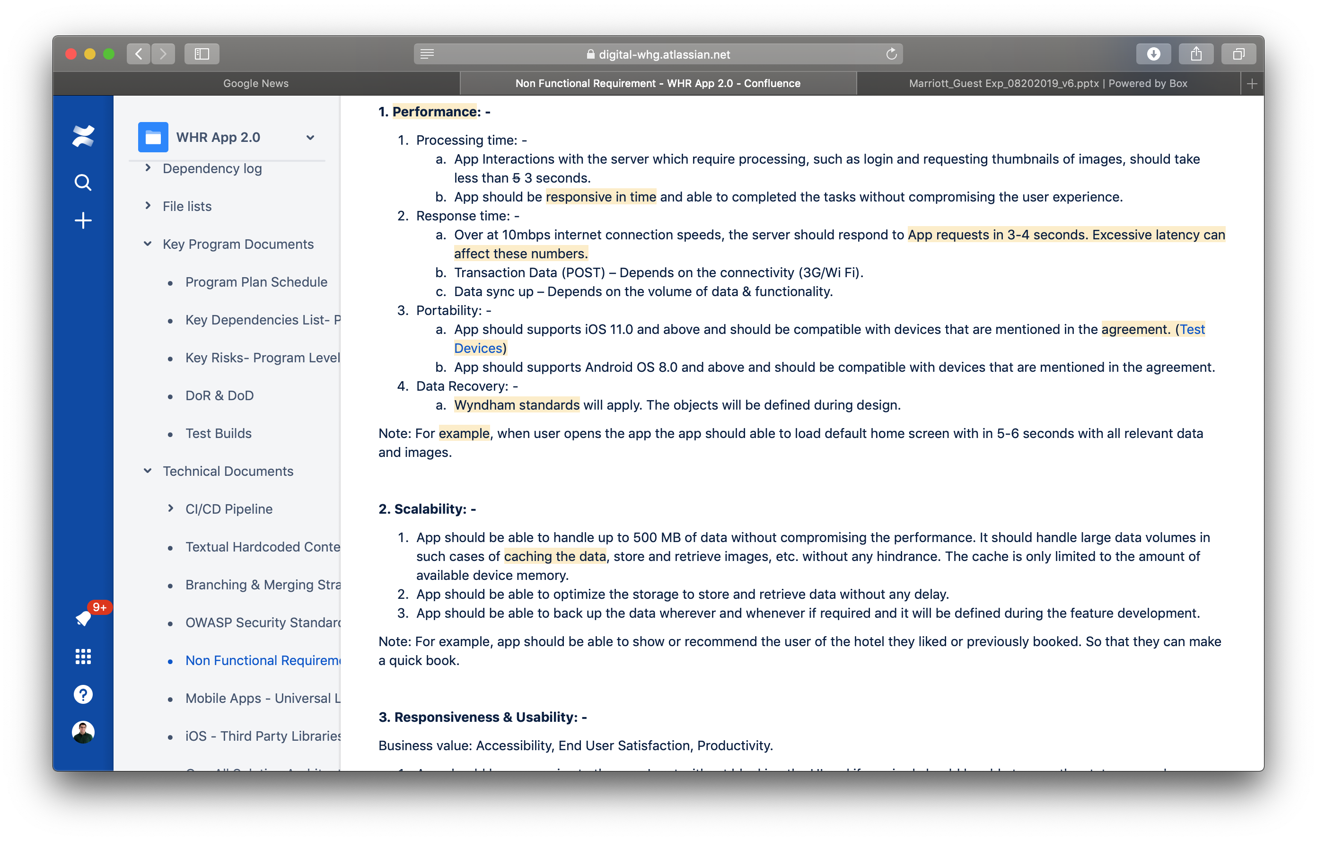
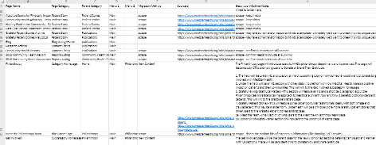
Key outputs of our process
// EXPERIENCE STRATEGY
Research Plan | Personas | Story Map | Backlog | Sitemap
Research plans formalize the objectives, methods of measurement, and n values required to achieve significance | Personas are portraits of a specific users, their motivations, wants, and needs | A (user) story map is a dynamic visual tool to assist in the creation of a product backlog and roadmap | A backlog defines the highest priority features for a single or multiple releases by organizing features within epics, stories and tasks | A sitemap that defines the information architecture including the structure, taxonomy, and nomenclature of the experience
// BUSINESS STRATEGY
Stakeholder Workshops | Business Requirements
Workshops enable people of the organization to provide input into the product | Requirements document aspects of the experience that must be delivered in specific ways
// CONTENT STRATEGY
Content Blueprint
The blueprint maps the information included on and tools linked to from each dashboard in the experience

Slide 27
How we turn strategy into sprint plans & product
RESEARCH
STRATEGY
DESIGN
BUILD
LAUNCH
MONITOR & OPTIMIZE
Looking at the problem from all angles – business, people, technology
Sensemaking & co-creating to develop product vision, personas, concepts, and roadmap
Define technical solution architecture and integration strategy
Identifying requirements, feature lists, user stories, and build plan
Creating a comprehensive agile sprint plan to build the new experience
Designing the new experience with best-in-class creative
Iterative and seamless hand-offs between design and development
Deploying myVantage app to UAT environment for business validation and feedback
Iteratively improving the product with learnings from UAT
Production cutover and monitor
EVOLVE
Integration with Experience Strategy & User Research

Slide 28
Design and build: key activities and deliverables
// DESIGN
// BUILD
SIX 2-WEEK SPRINTS
SIX 2-WEEK SPRINTS
DESIGNING THE MYVANTAGE EXPERIENCE
BRINGING THE MYVANTAGE EXPERIENCE TO LIFE
UX and visual design UX copywriting Clickable prototype development Information architecture refinement User story development & prioritization
/ Core services development / Composite services build out/orchestration for lifecycle workflows / UI development / Integration for myVantage Analytics / SSO design and framework / Logging, auditing services / DevOps pipeline buildout / Cloud gate integration / Meta data design and DB changes / Backlog prioritization and refinement
ACTIVITIES
Refined sitemap
High fidelity clickable prototypes for Desktop, Tablet, and Mobile
Style and pattern guide
Iterative handoffs from design to development team
/ Deployed UI, Services, SSO framework and other Integration code on the Test environment
/ Code scanning results for validations
/ Integration or other functional test results post deployment to test environment
/ Design document updates if any
DELIVERABLES

Slide 29

Our integrated process
We will follow a rapid feature-driven iterative development process that will drive re-usability, agility and faster time to market for this MVP. The prioritized backlog will be developed, tested and deployed collaboratively in adherence to the development practices.
RESEARCH & STRATEGY
FEATURE 1
DESIGN AND BUILD
MULTIPLE ITERATIONS ON AGILE MODEL
RELEASE & SUPPORT
FEATURE 2
2 WEEK SPRINTS
CONTINUOUS INTEGRATION & DEPLOYMENT
PRODUCT RELEASES AS MVP
AND POST-MVP FEATURE RELEASE
FEATURE N
FEATURES
Sprint planning & grooming
Design & coding
Unit tests(TDD)
Integration with dependencies
Functional validation
CI to the integration environment
CD to the test environment for testing
Feature demo
Retro
REFINED PRODUCT BACKLOG
LAUNCH MVP PILOT AND COLLECT FEEDBACK
INVENTORY
FUTURE STATE
TECHNOLOGY BLUEPRINT - REUSE & MODULAR ARCHITECTURE
Research & Insights
For Better Customer Experience
Leveraging Cloud Gate/CICD for
Speed and Quality
Leveraging Standard SSO and CBRE Apps API for Integration

Slide 30

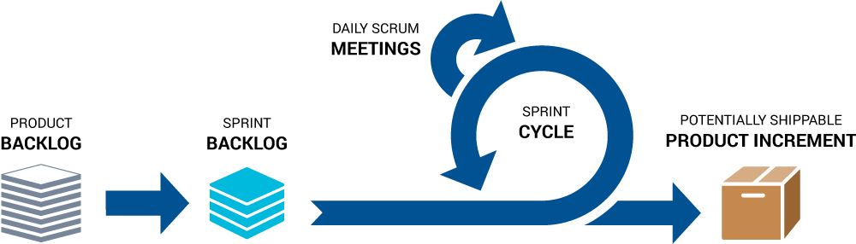
Our two-week sprint methodology
CLOUD GATE
Continuous Integration, Continuous Testing & Continuous Deployment
WEEK 1 | WEEK 2
Design sprint kickoff/backlog grooming
Rapidly design and iterate on concepts and features
Collaborative design review sessions with CBRE
UI/UX DESIGN SPRINT N
Handoff to Dev
Prototype review meeting
Acceptance
Dev sprint kickoff/backlog grooming
BUILD SPRINT N -1
Deployed for UAT Validation

Slide 31
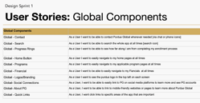
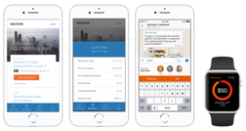
Key outputs of our process
// PRODUCT REALIZATION and DESIGN
User Story Development | Hi-fidelity Clickable Prototypes | Design Systems | Sitemap
A user story is a requirement expressed from the perspective of an end-user goal | Clickable prototypes showcase how flows, features, and visual design come to life | Design systems identify the design architecture for color, fonts, and UI patterns | A sitemap that defines the information architecture including the structure, taxonomy, and nomenclature of the experience
Notes:
Information Architecture
Style Guides
User research report

Slide 32



A closer look: DevOps pipeline leveraging CBRE CloudGate standards
Nunit
ENVIRONMENTS
MS Build
Azure Artifacts
Unit Testing
Run
Unit Tests
Build Automation
Artifacts Management
DevOps Portal
Update
Azure DevOps Repo
Git Model/
DevOps Portal update
Developer
Azure DevOps
Application Lifecycle Management
(APM ID)
Source Code Version (SCM)
Continuous Integration
Report
Status
Deployment Automation
Commit code
Pull
code
Deploy
Artifacts
Service Now
DevOps Portal
Onboarding
Azure web App
Static Code Analysis
Azure DevOps/
CI Pipeline
Manual / Automation
Requirement
Traceability
SonarQube
Infrastrure Provisioning & Configuration Automation
Dev
Prod
Code Review
Static Code Analysis
App.
Env Configs
Tester
ARM Templates
QA
Peer Code Review
Functional/Integration /Device/Performance Testing
Checklist update
Azure DevOps
Appscan/ Fortify/ Jmeter/ Nuget/ MSTest
C#/Selenium/ BDD-Specflow
Release Management
Azure DevOps
reports
Log Management & Monitoring
Application Insights
CBRE DEVOPS PORTAL AND METRICS ARE UPDATED AT ALL STAGES AS PER CLOUD GATE RECOMMENDATION FOR GATE APPROVALS

Slide 33


A closer look: Our approach for SSO myVantage Portal and CBRE Apps
INITIAL POV & ASSUMPTIONS
Users are authenticated using Azure AD B2C tenant, which will hold users details of CBRE and Client users
CBRE/Third party Applications which required SSO from myVantage portal
Users of those applications needs to be migrated in Azure AD B2C
Authentication Protocol for myVantage portal and applications required SSO should follow the same Protocol (SAML or Open ID Connect)
We can design myVantage portal support SAML or Open Id protocol but application's needs SSO also follow the same protocol
All applications which requires SSO from myVantage portal needs to be migrated to Azure AD B2C and support any one authentication protocol supported by myVantage Portal
Azure AD B2C does not support more than one authentication protocol in parallel for an application at a time.
CBRE
CLIENTS
CBRE/Third party Apps
To Enable SSO
Azure AD B2C
CBRE/
MyVantage Portal
Returns SSO Tokens
SAML or
Open Id Connect
Validate Tokens
SEQUENTRA
Validate User Credentials
Login
SEQUENTRA
KAHUA
KAHUA
SI
Send SAML Or Open Id Connect Tokens
SI

Slide 34
How we launch, monitor & optimize
RESEARCH
STRATEGY
DESIGN
BUILD
LAUNCH
MONITOR & OPTIMIZE
Looking at the problem from all angles – business, people, technology
Sensemaking & co-creating to develop product vision, personas, concepts, and roadmap
Define technical solution architecture and integration strategy
Identifying requirements, feature lists, user stories, and build plan
Creating a comprehensive agile sprint plan to build the new experience
Designing the new experience with best-in-class creative
Iterative and seamless hand-offs between design and development
Deploying myVantage app to UAT environment for business validation and feedback
Iteratively improving the product with learnings from UAT
Production cutover and monitor
EVOLVE
Integration with Experience Strategy & User Research

Slide 35
Launch, monitor and optimize: key activities and deliverables
// VALIDATE
// LAUNCH
// SUPPORT
WITHIN EACH SPRINT
MVP READY
2 WEEKS
MYVANTAGE USER ACCEPTANCE AND CUSTOMER EXPERIENCE TESTING
LAUNCH APPLICATION TO PRODUCTION ENVIRONMENT AND CUTOVER LAUNCH
HYPER CARE WARRANTY SUPPORT AND TRANSITION TO APP SUPPORT TEAM
In sprint product demos Test customer experience testing Sprint functional testing Nonfunctional validations UX/Design QA | Production deployment Launch customer cutover Customer feedback User acceptance testing | Hyper care period bug fixes Transition/KT to support team
Test results User feedback improvement Future backlog document | Production deployable code Customer feedback document | Transition KT document Hyper care bugs fixed and deployed
ACTIVITIES
DELIVERABLES
Notes:
Parth to update

Slide 36


Our testing automation approach for myVantage
WITHIN EACH SPRINT
MVP
READY (2 WEEKS PRIOR TO LAUNCH)
FUNCTIONAL AND STORY
PLANNING & DESIGN
FUNCTIONAL AND STORY TESTING
END TO END CERTIFICATION FOR LAUNCH
Test strategy & scoping
Sprint level test plan
Functional/story level test design
NFR & device test design
Test automation scripting sprint (N-1)
Test script maintenance
Functional testing
Impact based regression testing
Device / cross browser testing
Automation execution
Mock based testing for dependent systems
Early NFR testing (single user tests)
End to end functional testing
Complete regression testing
Automated test execution
Integration testing with dependent systems
Complete performance test execution
Test cases
Test scripts
Defects / observations
Test execution summary
Release summary report
Test execution & defect metrics
Performance testing report

Slide 37




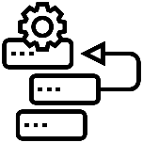

How we optimize testing and launching with Agile
Our Agile values and principles will ensure we are in a constantly experimenting and learning as we progress. Formal UAT periods are required at key milestones but there will also be ongoing constant testing within sprints
The Scrum framework means that we demonstrate our working software at regular (at least sprintly) intervals where the Product Owner is expected to inspect the product increment and request adaptions as required
The product owner’s role is responsible for maximizing the value of the product and does so by representing the users, who comprise both CBRE customers and internal stake holders
Involvement in the decision making throughout will result in a short and smooth final UAT period accelerating the rollout and making it easier to replicate
The process of inspection and adaption is not an opportunity to continually expand the backlog. Our primary aim is to meet the project objective within the time available
This will require pragmatism from the product owner and wider team to incrementally establish a fidelity (not to be confused with ‘quality’) of the solution that can be delivered within the time allowed

Slide 38
How we’ll deliver

Slide 39
We operationalize with a focus on value Bringing together product, design & development creates a core team that can clarify value, prioritize and deliver with a collectively aligned set of principles
OUR
STARTING
THREE
MAKE SMART DECISIONS
Understand the users
Define the problem and the vision to solve it
Ensure decisions are made to maximize business value by both design & engineering
PRODUCT
MANAGER
DESIGN
LEAD
DELIVER WITH SPEED & QUALITY
End the supply chain – gets insight as close as possible to the code
Have value-based framework for where to invest story points during requirements/design/architecture
Keep the project in balance to maximize return within timeline/budget – or make value based arguments for more time & budget to maximize return
FULL STACK
ARCHITECT

Slide 40





POD team structure and key roles
Cognizant proposes fixed capacity PODs that will engage with CBRE support PODs to turnaround prioritized features in a logical & efficient manner. Program governance and key roles on PODs will be based onshore.
STRATEGY & DESIGN
PROGRAM GOVERNANCE
CORE
UX
Lead
Design
Lead
Foresight Strategist
Ethnographer
Business
Owner
Product Owner
Program Manager
Product
Manager
SUPPORT POD
Designers
Content Strategist
UX
Writer
Editor
Project Managers
Full Stack
Architect
Experience Director
Research Sponsor
BUILD
Dev Manager
Product
Manager
Scrum
Master
Tech
Lead
DevOps
Architect
UI
Developers
Full Stack
Developers
.NET Developers
TEST ENGINEERING
Test Lead
Functional Testers
Performance Testers

Slide 41

Our governance structure
 | CBRE | COGNIZANT | COGNIZANT RESPONSIBILITY | STANDING MEETING TOPICS | MEETING FREQUENCY
STEERING COMMITTEE | Project Sponsor | Executive Sponsor | Overall leadership & direction Contractual audits | Business performance review Strategic planning | Quarterly
CORE TEAM | Marketing Team Technology Team Business Owner Product Owner | Engagement Lead Program Manager Experience Director Technology Lead Product Manager | Internal controls and audits and findings Overall delivery accountability | Operations SLA review against metrics Volume analysis and forecasting Strategic prioritization Thought leadership | Bi-Weekly / Monthly
DELIVERY ORGANIZATION | Marketing Team Technology Team Product Owner 3rd Party Teams (if applicable) | Design Lead Developers Test Lead Project Manager | Day to day execution Performance reporting against commitments Operational decision making and escalations Root cause analysis and tracking of key issues | Status updates Prioritization | Daily

Slide 42
Timeline - MVP
APRIL |  |  |  | MAY |  |  |  | JUNE |  |  |  |  | JULY |  |  |  | AUG |  |  |  |  | SEP |  |  |  | OCT
6 | 13 | 20 | 27 | 4 | 11 | 18 | 25 | 1 | 8 | 15 | 22 | 29 | 6 | 13 | 20 | 27 | 3 | 10 | 17 | 24 | 31 | 7 | 14 | 21 | 28 | 5 | 12 | 19
DESIGN STARTS
DEV STARTS
MVP LAUNCH
Kickoff & immersion
Storymapping/
Concepting
Research & Strategy
Interviews / field research
Product management / epic & story creation & refinement
Synthesis / personas
Content blueprint
UX copywriting
Information
architecture
Design
Design
sprint 1
Design
sprint 2
Design
sprint 3
Design
sprint 4
Design governance & QA
Development
Architecture Design
Dev
sprint 0
Dev
sprint 1
Dev
sprint 2
Dev
sprint 3
Dev
sprint 4
Dev
sprint 5
Dev
sprint 6
Hardening / UAT
Requirements gathering
Hypercare
CI/CD Test Automation

Slide 43
CBRE program commitment
PROJECT PHASE | TIME REQUIRED (PER WEEK)* | ROLE/ENGAGEMENT
Setup & Planning | 4-5 hours (first 2 weeks) | Business and technical architecture review, tools & Infra access approvals, planning and prioritization
Research & Strategy | As per schedule | Immersion: 8 hours to conduct kickoff & immersion activities, 10 hours for stakeholder interviews Field Research: 20 hours to conduct interviews Story mapping/Concepting: 8- 10 hours for story mapping a concepting workshop
Design | 2-3 hours | Review UX design, provide feedback and signoff on clickable prototypes
Build | 2-3 hours | 1 hour solution demo during development, provide feedback and signoffs and 1 hour at the start of each sprint for planning activities
UAT | 20-30 hours (final 2 weeks prior to launch) | UAT testing and production & deployment validation. Engaged in full UAT cycle to performance acceptance and validation tests.
*Hours are indicative, may not be applicable for every week

Slide 44




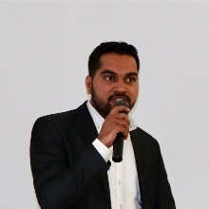



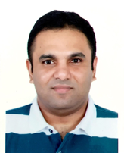

Meet your day 1 team
PROGRAM
RESEARCH & STRATEGY
IAN
PROGRAM MANAGER
EMMA | ALEXIS | ERIN | ATUL
SVP, GLOBAL INSIGHTS | STRATEGIST | ETHNOGRAPHER | PRODUCT MANAGER
DESIGN
BUILD
MITHUN | SENTHIL
ARCHITECT | TECH LEAD
JUSTIN | JIM | CHRIS | DAN
EXPERIENCE DIRECTOR | DESIGN LEAD | SENIOR UX DESIGNER | CONTENT STRATEGIST

Slide 45
Timeline - Post MVP (Illustrative)
OCT | NOV |  |  |  |  | DEC |  |  |  | JAN |  |  |  | FEB |  |  |  | MAR |  |  |  |  | APR
26 | 2 | 9 | 16 | 23 | 30 | 7 | 14 | 21 | 28 | 4 | 11 | 18 | 25 | 1 | 8 | 15 | 22 | 1 | 8 | 15 | 22 | 29 | 5 | 12
DESIGN STARTS
DEV STARTS
LAUNCH
Research & Strategy
Backlog / grooming
ILLUSTRATIVE VIEW
This is an illustrative timeline that will be defined based on a collaboratively-facilitated prioritization process at the beginning of the engagement and updated as needed prior to MVP launch.
Product management / epic & story refinement
Design
Concepting & IA
Design
sprint 1
Design
sprint 2
Design
sprint 3
Design
sprint 4
Hardening / UAT
Development
Requirements gathering
Dev
sprint 0
Dev
sprint 1
Dev
sprint 2
Dev
sprint 3
Dev
sprint 4
Dev
sprint 5
Hypercare
CI/CD Test Automation

Slide 46
Commercials
PHASE | COST
MVP | $___K
POST MVP | $___K
ASSUMPTIONS
Pricing will be finalized upon review between Cognizant & CBRE
Timelines assume April 6th kickoff
Post-MVP pricing is illustrative and will be refined as needed prior to MVP launch
Travel and expenses will be charged at actuals not to exceed 10% of total project cost

Slide 47
A bit more about us

Slide 48

Our vision is driven by our understanding of CBRE’s culture, operating practices and digital focus
5+
200+
130+
5
3
Years Working
Together
Associates
Globally
Applications
Supported
Global
Delivery centers
Countries
MAJOR ENGAGEMENTS
Managed Services | Valuation & Advisory | Global Workplace Solutions | Data Platform
Support for 130+ applications across various business domains and geographies 80+ FTEs | Agile POD based Delivery for valuations 40+ FTEs | Application Development for Lease management and Facility management solutions. Successful product build outs (myVantage, Cost Estimator) 20+ FTEs | Support CBRE’s data platform to facilitate analytics and reporting 25+ FTEs
X
We know each other well. Cognizant & CBRE have a long, proven history of successful partnerships

Slide 49



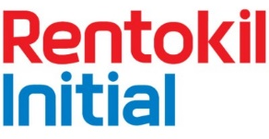







We are a leading digital partner in real estate
3 OF THE TOP 5
commercial real estate firms as clients
1000+
industry consultants
GLOBAL ENGAGEMENTS
across NA, EMEA & APAC

Slide 50
We rigorously apply a human centric lens to all we do, with ethnographic research at the core of our work
Our technology heritage lends an unconventional point of view towards marketing– social native, with a lean to video and new creative formats
We actively explore new and emerging technologies including AR/VR content, conversational AI, IoT, and more
We integrate with our Analytics and AI, digital engineering and connected products practices to deliver transformation and impact
Our secret sauce is not in what we do:
It’s how we bring it all together…

Slide 51







We offer leading experience design services globally
53 | 1,000 | 1,150 | 3,500 | 8,500 | 1,650
Offices Globally | Experience Design Specialists | Marketing Consultants | Creative and UX Designers | Digital Content & Social Specialists | Commerce Specialists
KEY ACQUISITIONS
Toronto, ON
London
Amsterdam
Paris
San Francisco, CA
New York
Philadelphia, PA
Madrid
Shanghai
Osaka
INDUSTRY RECOGNITION
Mexico
Hyderabad
Pune
Costa Rica
Chennai
Manila
#1 Digital Agency Network in the US
#3 Digital Agency Network in the World
2018 Agency Report
Brazil
Melbourne
8
Argentina

Slide 52
















Providing scale and agility through digital engineering
11,000⁺
DIGITAL ENGINEERS
30+
ENGINEERING
MANAGERS
750+
DIGITAL
ARCHITECTS
500+
AGILE &
SCRUM
MASTERS
800+
DEVOPS CONSULTANTS & ENGINEERS
2000+
UX / VD
SPECIALISTS
7000+
FULL STACK DEVELOPERS
KEY OFFERINGS
CONSULTING &
ADVISORY
GREEN FIELD / BROWN FIELD DEVELOPMENT
APPLICATION TRANSFORMATION
Product Development
Supply Chain Management
Merchandizing
Store
Operations
Multi
Channel
Sales &
Marketing
Customer
Management
Travel
Hospitality
Food & Beverages
Beauty & Cosmetics
Personal Care & Electronics
STUDIOS
ACCELERATORS
PARTNERSHIPS
OneDevOps
DevOps accelerator
OneModernize
App. Modernize framework
USA
UK
IND
ROM
AUS
ARG
CAN
VSM
Cloud Assessment
COSMOS
Micro Services Development

Slide 53
THANK YOU

Slide 54
Appendix

Slide 55
Feature details

Slide 56
Technical considerations for development
UI
Portal UI developed using Angular and supports Desktop, Tablet and Mobile devices
Provides support for multiple Language support (Internationalization)
Persona based UI renders based on specific User Role.
Options to customization of Layouts
Deployed as Azure Web
Microservices
Services are developed using .NET Core 3.0 to support Cross platform deployments
Services are designed based on business functionalities
Services are hosted as Azure Web App for high availability and scalability
Each of the services follows independent development and deployment life cycles
Authentication/SSO
Azure B2C and Azure Ad used for Authentication of CBRE and External client users
Single Sign- on is enabled with Other interfacing Application and supports SAML, Oauth and OpenId Connect protocols
API Management Layer
Micro services are exposed to outside word securely by Azure API Manager layer
Azure Search
To Search the content across the portal
Azure CDN
Static images and contents are delivers though Azure CDN’s to increase the faster response time
Logging and Monitoring
Azure App insights used for logging and Monitoring of the services
Database
Azure SQL and PostgreSQL SQL
CI/CD
Each services will follow separate development cycle and deployed independently using best in class Azure DevOps framework
ChatBot
Azure QnA Maker will be used to crate Chat Bot for more frequently used Questions and Answer
Live Chat Agent
TBD

Slide 57
Research & Strategy Detailed View

Slide 58
Research & strategy detailed view
phase 01 Kickoff & Immersion 2 weeks
phase 02 Understanding the Users 5 weeks
1.1 Kickoff & Alignment
1 Day (In-person, concurrent with 1.2)
To initiate the project and ensure we are all starting from the same place, we will have an in person kick-off to establish core-team, align on objectives & outcomes, shape the scope, set into motion the timeline & establish how we will be working together.
1.2 Stakeholder Interviews
1 Week
Through one-on-one discussions, Cognizant will leverage the expertise of the steering committee and extended team that will be involved in activities stemming from the output of this project. We will conduct 7-10 Interviews with a focus on what is known and what is unknown, as well as familiarizing ourselves with tacit knowledge, and opinions about key project objectives & outcomes.
1.3 Immersion
1 Week (concurrent to 1.2)
Concurrently Cognizant will conduct a full document, business, and platform immersion to arm the team with a holistic understanding of the company’s realities, constraints, current efforts and desired future state myVantage Phase Two functions, goals, and KPIs.
1.4 Research Planning & Recruitment
1 Week
A Cognizant Design Researcher will develop the participant recruitment criteria, plan the research activities, and work with CBRE to schedule remote one-to-one interviews with a total of twenty participants across relevant user groups. These in-depth interviews will be designed to ensure a targeted exploration of:
/ How users experience and perceive the current myVantage platform
/ How users envision and prioritize more robust improvements for future state applications
2.1 User Immersion
2 Weeks
Cognizant will conduct in-person research with relevant user groups to understand the current state of the myVantage user experience. Through in-depth interviews, Cognizant will explore users’ pain points, priorities and key aspirations for a future-state experience. User Immersions will also entail, where applicable, remote observations of users’ engagement with the current applications.
The outcomes of the research will be used to identify how myVantage Phase Two can best address users’ needs and aspirations from a holistic perspective, with emphasis on the full client lifecycle.
2.2 Topline Insights & Persona Development
2 Weeks (1 week concurrent to 2.1)
To ensure that the resulting myVantage Phase Two experience truly resonates with our target customers, Cognizant Interactive will leverage the immersion learnings to produce Topline Insights and a set of User Personas.
Topline Insights identify patterns in user research that bring to light the design and experience implications for the future state product or service being built.
User Personas are distinct archetypal representations that reflect the roles, behaviors, and attitudes of current and potential myVantage users, and what matters most to them. The Personas will serve as a foundation for designing the ideal user experience in the succeeding phases. They will be composed of, not limited to:
Priorities and goals
Behaviors and motivations
Stated and latent needs
Pain points and concerns

Slide 59
Research & strategy detailed view
phase 02 Understanding the Users (con’t) 5 weeks
2.3 Story Mapping Workshop
1 Day
A story map is a dynamic visual tool to assist in the creation of a backlog. It helps communicate the functionality of the product, service, or system from the perspective of the end-user(s). It also helps identify omissions in the backlog and helps the team plan prioritized releases that deliver measurable value to users and the business with each release.
The following are the typical steps taken in a Story Mapping workshop:
Define features and functionality chronologically by epic
Organize stories by specific user type
Box out sections for sprints or releases
2.5 Concept Co-Creation
2 weeks (1 week concurrent to 2.4)
Working with our core client team, and with our immersion and user research insights in hand, we will identify potential experience improvements and develop concepts addressing current pain points we will utilize in design.
Key Assumptions User Group Identification: CBRE to provide number of user groups to be included in research. This will impact the types of research activities, duration, and number of sessions. Access to current tools & documentation: CBRE to provide access to current tools and documentation prior to project kickoff. This is critical for the initial immersion activities. Availability for User Research: CBRE to support scheduling of activities for user research. To be identified in research plan. Review: Time from stakeholders to review progress and provide feedback.
Key Team Members Exec Sponsor Strategist Design Researcher Product Owner Graphic Designer Project Manager Recruitment Coordinator UX Strategist Content Strategist
Phase 01 + 02 Deliverables Project Charter: Establishes the objectives, timeline, outputs and roles and responsibilities (Word Doc) Personas: Distinct archetypal representations that reflect the roles, behaviors, and attitudes of current and potential users (PDF) Story Map: A visual map of the end-to-end product features (PDF) Backlog: A prioritized list of user stories broken out by sprint
2.6 Backlog Development
1 Week (concurrent to 2.5)
From the Story Map, the Cognizant team will flush out a set of user stories. This will be shared back with the CBRE team for review and approval. These user stories will represent all of the features that will go into the product. We will then organize features into sprints, starting with the foundational features and those which are highest priority to users. The backlog will be a living tool that is updated daily throughout the course of the product.
2.4 Synthesis
1 Week
With the learning unearthed during the preceding activities in phase 02, Cognizant Interactive will synthesize and analyze those learnings as we move into concept co-creation.

Slide 60
Assumptions & Dependencies

Slide 61
Assumptions & dependencies
DESIGN & BUILD
myVantage MVP application is developed on top of existing myVantage sales demo application
CBRE will provide all required software and development environments for design and development of application
Azure B2C application tenant will be available before development phase
CBRE will onboard all client details in Azure B2C
Azure B2C used to mange user details and hence no user data managed in application
Admin screens will be created to mange only role to functionality mapping
Level of customization required will be discussed in detail during story mapping and concept creation phase
To enable SSO with other applications like Sequentra, Kahua, SI etc., those application teams makes changes at their end to accept the tokens from My Vantage application
Efforts provided are based on high level understanding of application functionality, we need to revisit the efforts if major functionality changes identified during product catalogue grooming phase
Sales, Transition, Go live and Transformation process flows are defined during story mapping and concept creation phase
Tableau- Angular UI will display Tableau reports as in div or Iframe from MyVantage analytics application no additional effort required from myVantage application UI.
Third party software used for Live chat agent not developed as part the proposal.
UI Design system from myVantage MVP will be utilized and built upon
Adobe XD will be used for design, prototyping, and spec handoff to development teams
Each sprint will have 2 client reviews/revisions and signoff

Slide 62
Assumptions & dependencies
MANUAL TESTING
For Manual Testing on myVantage WebApplication Desktop, 1 Android, 1 iPhone & 1 iPad have been considered as primary device & 1 Android phone has been considered as secondary device.
In Desktop, 100% Test verifications ( UI & Functional) will be done on - Desktop & Primary Browsers (Chrome), 60% on Primary Mobile Device & Primary Browsers (Chrome), 30 % on Secondary Browsers
Test Execution coverage will be 100 % on Primary Language i.e. English; 20% Test Cases which are mostly UI validation will be done on Non-English Language.
Chrome Browser has been considered for testing on Desktop & Android devices. For iPhone & iPad Testing will be done on Safari.
Along with English Language, only 2 Non-English Languages will be considered for testing to verify the localization implementation. Increasing the scope of Localization verification will increase the effort.
Minimum 1 SauceLab License will be required for Manual Testing & 2 SauceLab licenses will be required for Automation testing.
~ 15 API has been considered for testing on Postman
Azure/VSTS has been considered for Test & Defect Management though it is not impacting the effort estimation
TEST AUTOMATION
Effort Estimation is done on MyVantage application considering the Test Automation framework is based out of Selenium.
Cognizant will do PoC for the feasibility of the test automation on the required devices. On success, automation would be kicked off with possible findings shared. Post PoC Cognizant will suggest the best fit test automation tool/framework.
Automation Estimation has been done considering MyVantage as Web Application running on Deskop & Native App developed for Android & iOS mobile.
60% of Total Test Cases have been considered for Automation testing in English language.
All the required devices(Android mobiles, iPhone, MacBook) needs to be provided by CBRE. If code needed to tested on Real Device, the code should be available in Cognizant Network. However to perform the Automation in CBRE Networ on SauceLab minimum 2 SauceLab Licenses would be required.
If automation in Sauce Lab is required, RAM needs to be upgraded to 8GB.
Service Accounts needs to be created to byPass MFA security
Automation on Desktop will be done on latest Chrome Browser which can also be executed in IE 11 (not on any other version or Edge)
Additional effort may require for any major changes in functionality or UI during automation development and execution.
Based on high level understanding it is assumed that the TCs in scope of Automation are 20% Complex, 40% Medium, 40% Simple
Change in complexity and total test case count will impact the estimates and will result in revision
Requirement clarification should be done by 1 Days aging.. Else there will be schedule variation
* PDF/Excel/Doc Report or Data and Map verification is made out of Automation scope.

Slide 63
Assumptions & dependencies
PERFORMANCE TESTING
The estimates are based on the assumption that connectivity, access, infrastructure, etc., will be available without interruption during performance testing. In case of issues like server-crashes during testing, disconnection of performance test analyst(s) from test-environment, etc., timelines will be impacted and additional effort will be required to complete the planned activities.
One round of successful load test for each sprint(from dev sprint 6) has been considered
The User ID's & Bulk Test data needed for conducting the load test should be provided by CBRE/Application team
Access to the performance-test environment (Web/App/DB/other relevant servers) will be provided to the Performance testing team to monitor server-health during the performance test executions. If such access is unavailable, the relevant team will monitor servers during execution and share the logs with the performance testing team
CBRE would provide a functionally stable (UAT or Pre-Production) environment for Performance Testing which is identical to production environment in terms of hardware capacity, software components etc
5 screens for each one of the mobile devices(1 iOS and 1 Andriod) would be in-scope. Devices to be provided by CBRE.

